Slide 1
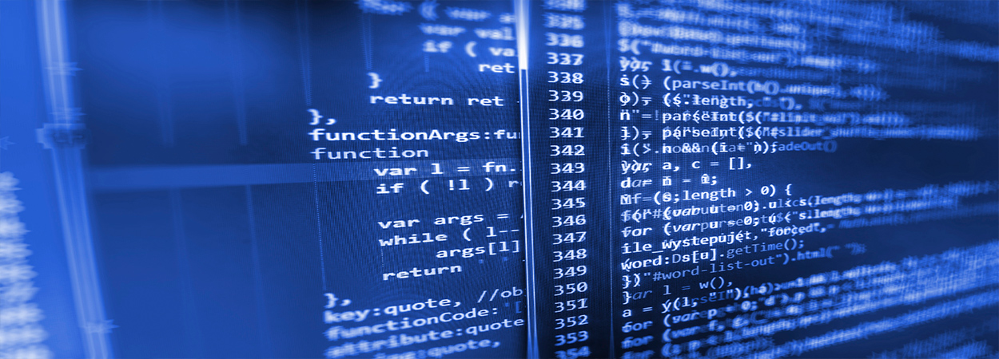
Modelling burn wound healing
Mark de Boer
Ben Dickens

Slide 2
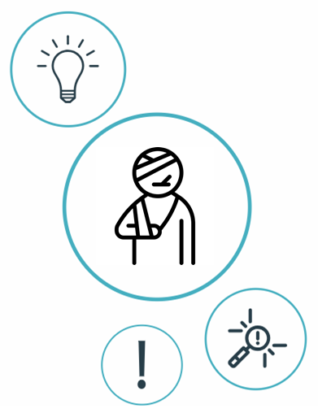
Index
Introduction
Aim
Previously built models
Proposal
Possible biomarkers
Possible sociomarkers
Data available?

Slide 3
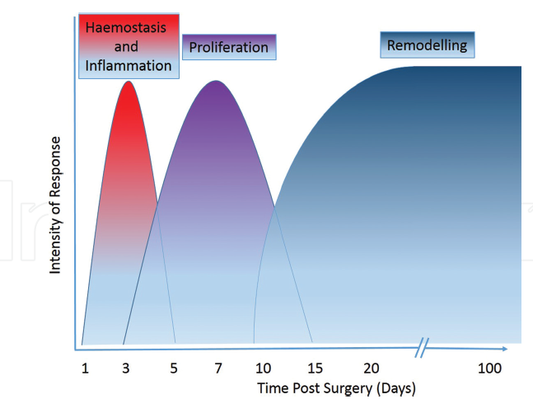
Stages of healing
Commonly divided into four overlapping stages.
When a patient comes in, they are likely to have gone through the first stage (Hemostasis) of response.
Controlling the inflammatory response is fundamental to the healing process:
Fight infection, clear debris and induce the proliferation phase <-> Tissue damage
Notes:
Inflammation helps, clear debris and induce the proliferation phase (fibroblasts entering, then angiogenesis), but may lead to tissue damage if it lasts too long. This is often the case when: unable to clear debris, excessive detritus, devitalised tissue, or microbial biofilm is present.

Slide 4
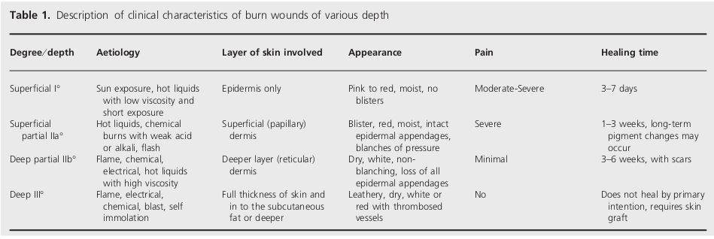
Variable burn wounds
Non-grafted
Grafted
Notes:
Main difference from cuteanous wounds is the the loss of the skin appendages and re-epithelialization, which can only occur from the edges of the wound.
more specific about what happens to the dermis and epidermis (necrosis, ischemia, stem cell hair follicles destroyed, coagulation, ITMs in blood stream etc) during a severe 2nd or 3rd degree burn (especially for AP/immunology expert).

Slide 5
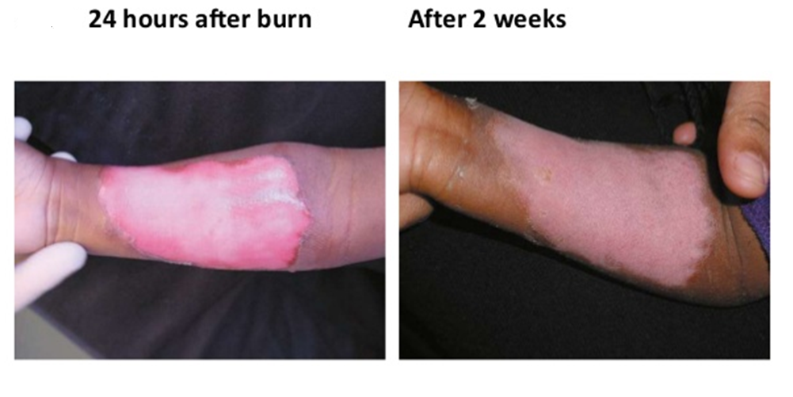
Main difference with cuteanous wounds is the the loss of the skin appendages and re-epithelialization, which can only occur from the edges of the wound
Hair follicles and sweat glands are completely destroyed and therefore can’t serve as sources of epithelial regrowth
Results in scarring
Notes:
glands that invaginate deep into the dermis and serve as efficient sources of epithelial regrowth after more superficial injury.

Slide 6
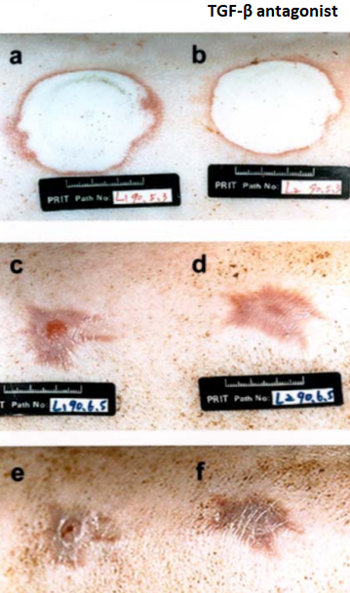
Effect of Immune system alterations
Application of a synthetic TGF-β antagonist accelerates re-epithelialization in pig burn wounds
(100% antagonist-treated wounds vs.
70% re-epithelialization in control wounds)
Reduces wound contraction and scarring in standard pig skin burn
Clinical trials are expensive
Computational modelling can serve as cheap alternative
Notes:
Wound healing consists of re-epithelialization, contraction and formation of granulation and scar tissue. TGF-β is involved in these events, but its exact roles are not well understood. Here we demonstrate that topical application of a synthetic TGF-β antagonist accelerates re-epithelialization in pig burn wounds (100% re-epithelialization in antagonist-treated wounds vs. ~ 70% reepithelialization in control wounds on postburn day 26) and reduces wound contraction and scarring in standard pig skin burn, pig skin excision and rabbit skin excision wounds.

Slide 7

Create a validated computational model of one or more stages of burn wound healing, that is linked to the HIIS model (co-evolution governed by exposure to blood supply).
Notes:
What causes a better healing of burn wounds?
Model the healing process to
investigate how all agents are influencing each other

Slide 8

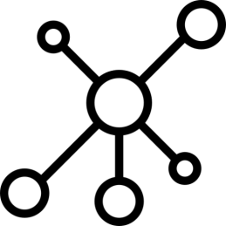
Previously built models
Dynamic computational frameworks simulating
separate burn/cutaneous wound healing stages:
Inflammation
Contraction/Remodeling
Angiogenesis
Dynamic computational Alkaline Phosphatase (AP) related innate immune system model.
Notes:
Perfect skin regeneration of burn wounds remains a challenge. There is still a lack of fundamental understanding of the interactions between different cell types, complex cell signalling networks and mechanical feedback loops during the wound healing process. Previous efforts have focused on constructing dynamic computational frameworks simulating cutaneous wound healing [1,2,3], but have not focused on burn wound healing.
In addition, dynamic computational models have been used to study the inflammation process in wound healing. Presbitero et al. [4] constructed a validated numerical systemic inflammation model under clinical treatment conditions of the Alkaline Phosphatase enzyme. Alkaline phosphatase (AP) exhibits anti-inflammatory effects by dephosphorylating inflammation triggering moieties (ITMs) like bacterial lipopolysaccharides and extracellular nucleotides.
These models are all not burn wound specific, therefore adjustments or an expansion of these models are demanded, to simulate the burn wound procedure. The link between the AP model and the cutaneous wound healing models, has not been investigated/found yet. By first performing a literature review focused on possible connections, this will be investigated. Constructing a computational model simulating burn wound healing would be a step forward towards a better understanding of dynamical adaptation to heal burn wounds.
ABM: simulating the actions and interactions of autonomous agents (both individual or collective entities such as organizations or groups) with a view to assessing their effects on the system as a whole

Slide 9
Tepole et al. ~
Computational modeling of chemo-bio-mechanical
Coupling toward
wound healing
Flegg et al. ~
On the mathematical modeling of wound healing angiogenesis
Boon et al. ~
A multi-agent cell-based model for wound contraction
Li et al. 2011 ~ Biosimulation of Acute Phonotrauma: an Extended Model
2011
2014
2015
2016
2007
2013
2017
2018
Mi et al. ~
Agent-based model of inflammation and wound healing
Ziraldo et al. ~
Computational Modeling of Inflammation and Wound Healing
Tepole et al. ~
Computational systems mechanobiology of Wound Healing
Sloot et al. ~
Alkaline Phospatase and it’s role in the Immune System
Notes:
All models talk about validated models of different phases but not linked to the immune system model because came out in 2018. we only need the link

Slide 10
Sloot et al. 2018 ~ Alkaline Phospatase and it’s role in the Immune System
Simulates innate immune system
Models systemic insult (massive amount of ITMs) from multiple sources
Compartmentalized into: liver, blood stream, and tissue
Healing phases are dependent on the preceding spatio-temporal action of the IS
AP model is already sufficient to predict/protect against organ damage.
Notes:
This paper and therefore the “tissue” represents the entire body. It is. For severe burns, and the minimisation of scarring, we most likely need to introduce a cell agent based model that is coupled to the HIIS model. There are several interlinked phases of burn wound healing, each phase of the process is dependent on the preceding spatio-temporal action of the IS. E.g. the ECM cannot be remodelled until there has been sufficient angiogenesis.
suggests ATP and H202 may establish a pro-inflammatory permissive environment to potentiate the recruitment of immune cells into the inflamed tissue. Some evidence that atp enhances response to attractant by generating a signal amplification loop

Slide 11
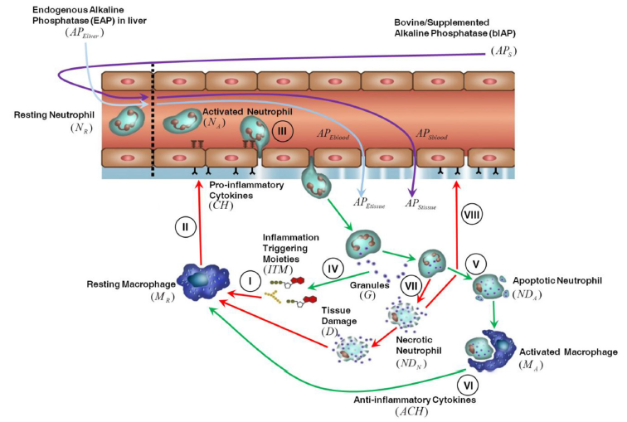
Inflammation Triggering
Moeties (ITMs)
Alkaline Phosphatase
Anti-inflammatory cytokines
Pro-inflammatory cytokines
Relevant cell
populations:
Macrophages
Neutrophils
Granules
Notes:
To the best of our
knowledge this is the first numerical model of a complex innate
immune response that is quantitatively validated with clinical
data. Our work paves the way to a deeper understanding of the
immunological mechanisms underpinning this important
innate immune response to oxidative stress mediated
inflammation.

Slide 12
Li et al. 2011 ~ Biosimulation of Acute Phonotrauma: an Extended Model
2-Dimensional ABM model
Inflammation + synthesis of collagen/elastin (link to contraction)
Relevant cell populations:
Platelets
Macrophages
Neutrophils
Fibroblasts
Fibres:
Collagen
Elastin
Key effector cytokines :
TNF-α
IL-1/6/8/10
TGF-β1
bFGF

Slide 13
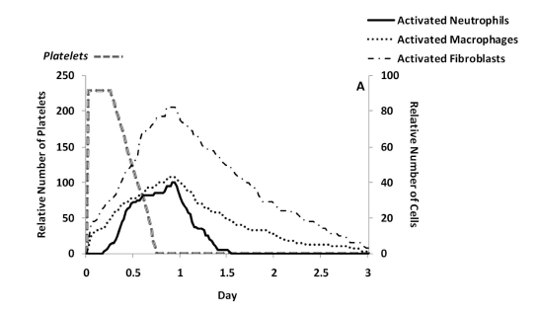
Predicted cell trajectories for platelets, activated neutrophils, activated macrophages and activated fibroblasts.
Predicted ECM trajectories for new collagen, elastin and hyaluronan
Notes:
Hyaluronan (volgens oudere nomenclatuur ook hyaluronzuur of hyaluronaat genoemd) is een glycosaminoglycaan dat veelvuldig in bindweefsel, epitheelweefsel en zenuwweefsel voorkomt. Het is een van de belangrijkste componenten van de extracellulaire matrix, en draagt in belangrijke mate bij aan de celproliferatie en -migratie en is wellicht ook betrokken bij de progressie van sommige tumoren.

Slide 14
Ziraldo et al. 2013 ~ Computational Modeling of Inflammation and Wound Healing
2-Dimensional ABM model
Inflammation
Relevant cell populations:
Endothelial cells
Macrophages
Neutrophils
Fibroblasts
Key effector
cytokines :
TNF-α
IL-1β
IL-10T
TGF-β1

Slide 15
Boon et al. 2016 ~ A multi-agent cell-based model for wound contraction
3-Dimensional multi-agent cell-based hybrid model
Contraction (The mechanical pulling of (myo-)fibroblasts on the ECM)
Relevant cell populations:
Leukocytes (to simplify)
Fibroblasts
myofibroblasts
Fibres:
Collagen
Fibrin
Key effector Cytokines/ Chemokines :
tPA
PDGF
TGF-β

Slide 16
3D Fibrin profiles at consecutive times for t=0h, t=1h, t=2h and t=5 h.
Also for Collagen/TGF, etc...

Slide 17
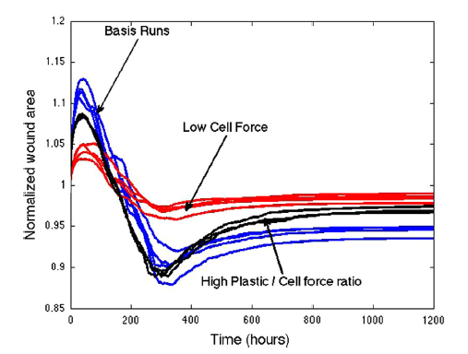
One of the most problematic issues regarding severe burns or deep wounds is the permanent contraction of the wound.
Influence of ‘Cell Force’ on the normalized wound area
Notes:
Fibroblasts located outside the wounds -> in undamaged tissue so first expands, cause already pulling
Fibroblasts into the wound

Slide 18
Tepole et al. 2017 ~ Computational systems mechanobiology of Wound Healing
2-Dimensional EBM model
Proliferation and Remodeling
Modeling Angiogenesis, Contraction and Re-epithelialization
Relevant cell populations:
Endothelial cells
Macrophages
Fibroblasts
Myofibroblasts
Keratinocytes
Key effector cytokines:
TGF-α
FGF-7
DGF
TGF-β1
FGF(1,2,4)
VEGF

Slide 19

What is the link between the innate immune system model and the wound healing process?
No other papers have modeled this relationship
Several validated models simulate one/two phases of wound healing.
These models only consider the immune system indirectly, while usually explicitly referring to the specific cytokines that activated macrophages release such as TGF-β, TNF-α and interleukins.
Using the same cell populations as the immune system model,
e.g. pro/anti inflammatory cytokines, activated/resting leukocytes, etc.
Essentially, once we have connected the HIIS model to the specific cytokines involved in almost all aspects of the healing process (TGFB,FGF,PDGF, VEGF, TNFa, IL), much of the legwork has been done by these papers.
Integrate the innate immune system model with inflammation
Extend the model for the proliferation, contraction, and remodelling
Angiogenesis (biggest challenge)
Notes:
Several of the papers, have validated collagen deposit rates in the presence of inflammatory signals and chemokines, but rely on accurate tissue and blood composition.
Specifically, as far as I can tell, every phase of healing is connected to the immune system but no other papers have modeled this relationship. If we have a validated model connecting AP to any phase of wound healing, is essentially novel research but the inflammation phase is intuitively the best place to start. We should seriously think about how we would be able to validate this though, although the original paper is directly concerned with inflammation (although a different type than that found in wound healing)

Slide 20

Proposal
Discrete Spatio-temporal (existing in both space and time) Agent-Based Model combining both the immune response model and the ABM wound healing models
The HIIS model will act like an engine for the blood composition of a 2/3-dimensional ABM model.

Slide 21
Approach
Measure which cells and anti- and pro-inflammatory cytokines are in the wound and blood stream after a severe burn. (Data probably already available?)
Configure and tune our 2D inflammation ABM using this knowledge
3. Link the ABM to the HIIS model via the cytokine and cell concentrations of the models
How is the inflammation process affected by the balance of cytokines in the bloodstream?
Later, this co-evolution scales with exposure to blood supply, for now leave constant.
Does a 2D model accurately capture dynamics? if not extend to 3D
Validate the model
From here we can start experimenting and extending (proliferation, angiogenesis, contraction, once we have a valid model).

Slide 22

Cytokine composition of inner and outer areas of wound and in blood stream. | For an integrated model we will need to translate between specific cytokines and the general categories the AP model uses.
TGF-β | Released by macrophages Attracts macrophages and fibroblasts Stimulates resting monocytes – upregulates inflammatory response While also downregulating cytokine production in monocytes and macrophages inhibits activated macrophages
Liver enzymes (AST, ALT) Biochemical Changes in Burns – Adiga et Adiga, 2015 | Excessive levels indicate hepatocytic injury (ALT being the most sensitive indicator). May be predictors of prognosis in burns injury.
Interleukins IL-(1B,6,8,10) | 6 – Found to be the cytokine whose levels predict patient outcome. Correlates with infection/sepsis. Correlates with severity of burn injury. 10-used in design of AP model.
TNF-α | Initiating factor in the activation of the host response and subsequent cytokine release during trauma. Correlates with the severity of burn injury. Pro-angiogenic factor.
Procalcitonin(PCT) & C-reactive protein(CRP) | Sepsis. PCT is the most reliable measure of sepsis. CRP is often used as a general proxy to characterise inflammatory status.
Leptin | Stimulated by pro-inflammatory cytokines (eg IL and TNFa). Cytokine-like hormone that links nutritional status with the immune system, while enhances innate(+adaptive) immunity. Related to regulation of stress. Pro-angiogenic factor.
Full blood Count | Haemoglobin (blood count) White Cell Count (WCC) Platelet Count
Stress biomarkers | Cortisol ACTH TNF-α and IL
Temperature | Wound and body
Matrix metalloproteinase (MMP)-8 | Involved in remodeling process, probably not that useful for now.
Relevant Biomarkers

Slide 23

Relevant parameters/markers
Geometrical Paramaters:
Length
Width
Depth of burn
Surface
Volume
Total Body surface area of burn (TBSA)
Burn Location/s
Body fat %
Tissue scattering, Location of hemoglobin molecules
(High hemoglobin content in the zone of hyperemia)
Macromolecular collagen structure
(native or denatured)
Pigmentation
Relevant Socio-markers
Age
Weight
Height
Gender
Alcohol / Drug use

Slide 24

Data available?
Collecting data will give us a way of assessing what balance of pro and inflammatory cytokines leads to best outcomes.
Age and other socio-markers are important too (e.g. the elderly scar less but heal slower). Several correlations have been established already.
Notes:
We should seriously think about how we would be able to validate this though

Slide 25
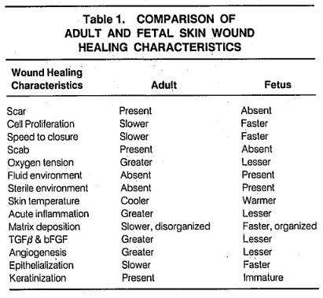
Anti-TGF-β Hypothesis
We (and others) hypothesise that anti-TGF-β therapies later in the healing process may lead to less scarring but slower healing.
Red deer antler (traditional Chinese medicine) ointment found to modulate TGF-β levels and improve cutaneous wound healing outcomes in full-thickness rat models (Gu et al., 2008)
Scarring in adults associated with excessive action of TGF-β
Scarless fetal wounds are relatively deficient in the inflammatory cytokine TGFB (also sparse inflammatory response (reduced macrophage and monocyte infiltrates, absence of endogenous immunoglobulins at the wound site, reduced angiogenesis, and altered levels of peptide growth factors) (Adzick and Lorenz, 1994)
It appears that adult wounds may be optimised for speed of healing under adverse conditions, resulting in excessive inflammatory infiltrate and cytokine profile (Adzick and Lorenz, 1994)
Modulation of AP (through interaction with macrophages) may in fact work in this capacity. (“only” speculation until we validate model).

Slide 26
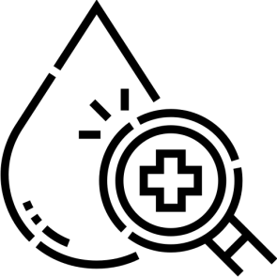
Blood Composition
Pro-inflammatory Cytokines:
IL-8
IL-6
IL-1β
TNF-α
Anti-inflammatory Cytokines
Interleukin 10 (IL-10)
IL-6
TGF-β
Other:
C-reactive protein (CRP)
Leptin
Neutrophils
Macrophages
TGF-α

Slide 27
Plan for the Next 2 Weeks
Conceptualize the inflammation-immune 2D ABM (i.e. Cell populations, cytokines …) in general terms: How do the cytokines interact? What level of abstraction necessary? Which modeling framework? (Most likely Mesa/python3)
Find all available data on blood, wound and immune composition and their interactions.

Slide 28
Questions for Ruud
How much resolution (of the HIIS) is lost by grouping pro and anti inflammatory cytokines of the immune system?
To what extent would anti-inflammatory action undermine the signaling function of inflammatory cytokines?
Most probable link between the HIIS and the different stages?

Slide 29
Questions for Paul
To what extent does slowing the rate of healing increase the risk of infection and other complications? (how often are later stage complications genuinely problematic? Is it dangerous to try to minimise scarring?
What challenge is posed by skin grafting and what makes the grafting more successful (e.g. Does it the underlying fibrin/collagen make-up affect surgery)?
Which stage of wound healing process poses the greatest challenge for minimising damage/ maximising health outcomes?
Do you want us to look at grafted or non-grafted skin healing?
current state of the art? What methods are used in different stages?

Slide 30
Questions for Both
“AP plays a key role in the maintenance and restoration of physiological barriers” …
What kind of interests or priorities do you have, in terms of improving the burn healing process or understanding the interaction between the immune system and healing? (exploratory or focused? What kind of work would be most extendable and impactful in your opinion? What function would you like this research to fulfill?)

